Slide 1
GAR
Session 02: Flappy Bird
Notes:
Welcome. Today we build Flappy Bird. The main topic: structuring the code.
Start by playing the finished game, Flappy12, before any code.

Slide 2
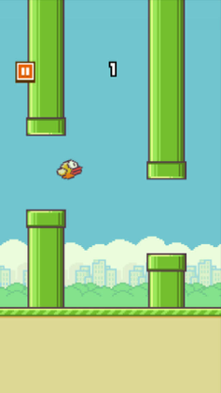
Flappy Bird
Flappy Bird (dotGears, 2013). Screenshot © dotGears.
Notes:
The original: Flappy Bird. Ask who has played it, and what they remember of how it plays.
Today we build the parts that matter for the architecture.

Slide 3
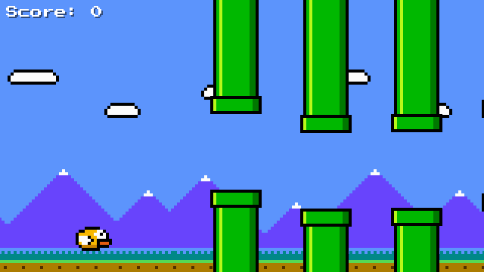
Today’s Goal
Notes:
Run Flappy12 and play it for a minute.
Ask: what would you need to build this? Collect answers on the board, and come back to them at the end.

Slide 4
Today’s Topics
Main topic: Structuring the code
Game Architecture
Class Libraries
Images
Parallax Scrolling
Procedural Generation
State Machines
Interfaces
Singleton Pattern
Notes:
Today’s main topic is structuring the code as the game grows. We move shared code into a class library, and the game’s modes into a state machine.
Every topic has a section on the course site.

Slide 5
Game Architecture
What is good software architecture?
  Change
  Decoupling
  Cost
  Performance
Notes:
Ask: what makes software architecture good? Collect answers, then land on the four on the slide.
The one to remember: good architecture makes change cheap.

Slide 6
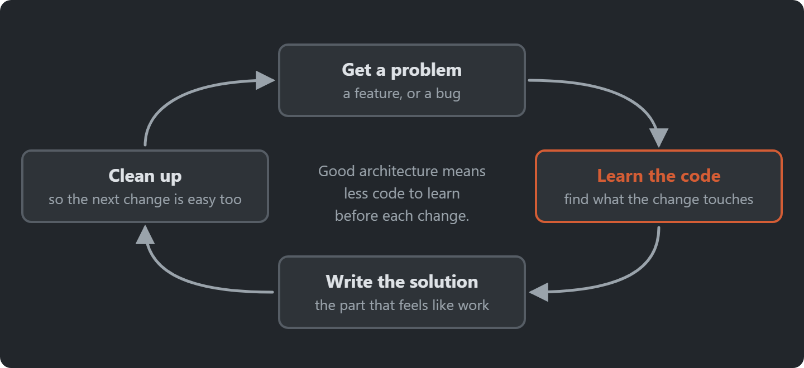
Notes:
The cycle of a change: understand the problem, learn the code, write the solution, clean up. Architecture shortens the “learn the code” step.

Slide 7
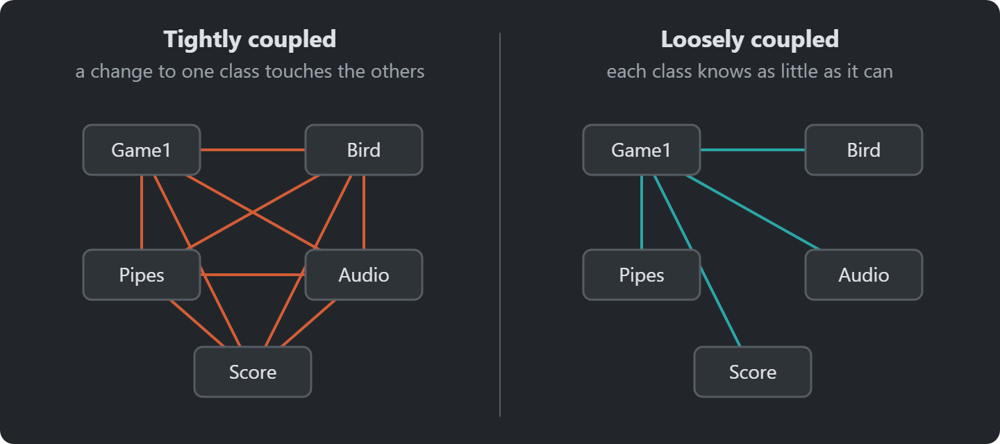
Coupling & Cohesion
Notes:
Coupling: how much parts depend on each other (want low). Cohesion: how much a part’s own code belongs together (want high).
Ask: which picture would you rather change?

Slide 8
Design Patterns
Named, reusable solutions to recurring design problems
A shared vocabulary for talking about code
Notes:
Named, reusable solutions to recurring design problems. A shared vocabulary: “make it a state machine” says a lot in four words.

Slide 9
Source Code
github.com/Metamate/gar-games, folder 02-flappy-bird
Its README: the steps (Flappy0 to Flappy12), where things are in the code, how to run it
The course site: today’s concepts in full, the exercises, and questions to check yourself
Notes:
Open gar-games/02-flappy-bird live. Show the README: the step table, the code map, how to run a step.
Say: the site explains the ideas, the README helps you find them in the code, the slides are for today.

Slide 10
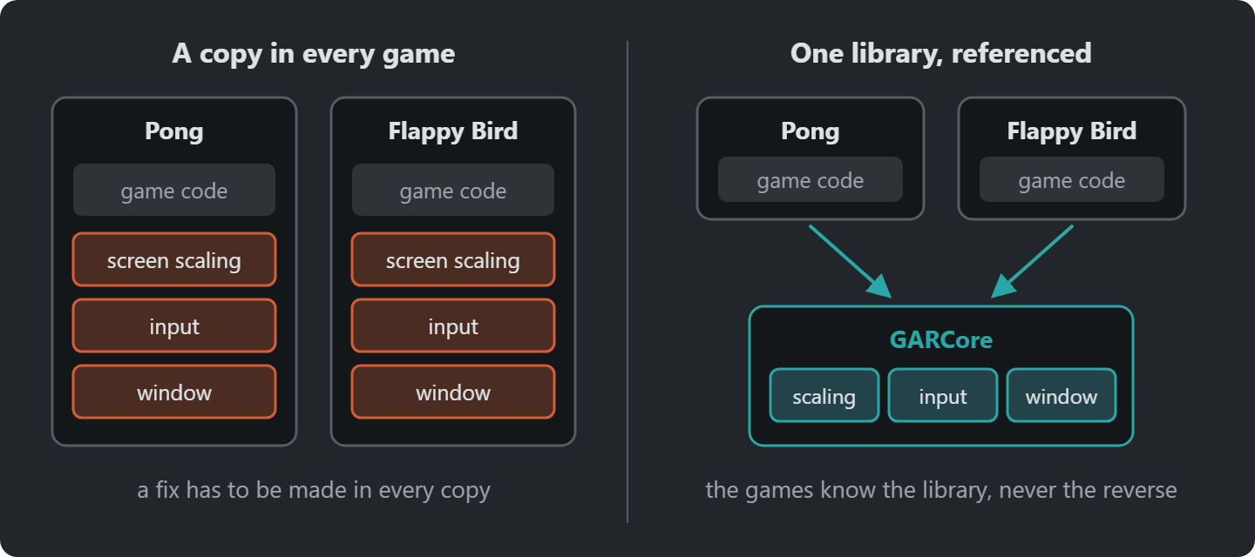
Class Library
Notes:
Pong copied everything into one project. Code every game needs (window, scaling, input) belongs in a library that every game references.
GARCore is referenced by each game, and it grows through the course.

Slide 11
Flappy -1: A Class Library
Goal: move what every game needs into a class library, GARCore.
A Core class, derived from Game: the window, and the screen scaling from Pong.
uses
Flappy
GARCore
Core : Game · window · scaling
Snake, Sokoban, ...
Notes:
Exercise: a repository from gar-starter, which comes with an empty GARCore library. They write a Core class in it that derives from Game and owns the window and screen scaling.
Before they code, ask: where is the library connected to the game, and which way does the reference point? Answer: the ProjectReference in the game’s .csproj; the game knows the library, never the other way round. So nothing in Core may mention Flappy.
Full instructions are on the course site; students work from there. Walk round while they work.

Slide 12

Flappy 0: A Game on the Library
Goal: a new game, Flappy, whose Game1 derives from Core.
640 × 360 virtual resolution in a 1280 × 720 window.
Notes:
Exercise: Game1 derives from Core. The window should look like the screenshot.
Full instructions are on the course site; students work from there. Walk round while they work.

Slide 13
Images
Remember from Pong?
  Just a Texture2D!
Notes:
An image is just a Texture2D, like Pong’s white pixel, but loaded from a file.

Slide 14
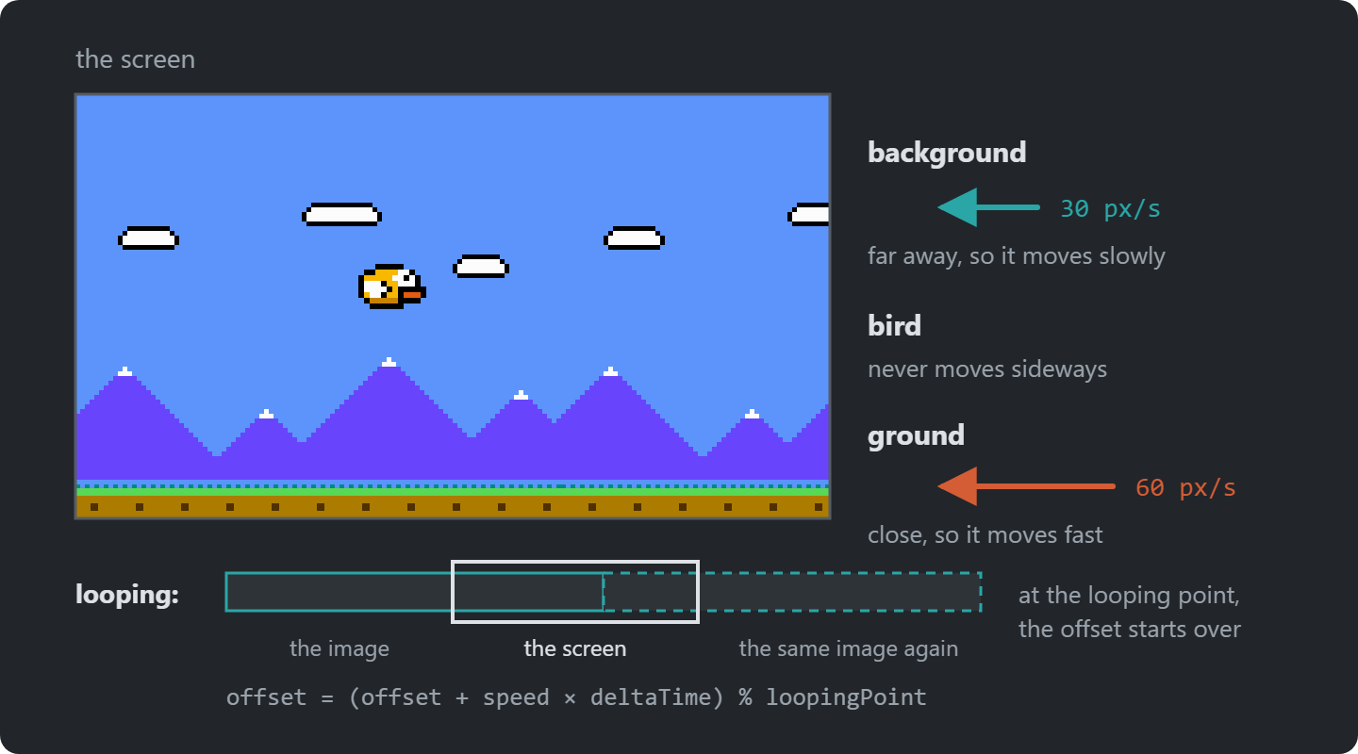
Parallax Scrolling
Layers that scroll at different speeds look as if they are at different distances
Notes:
Things further away move slower. Two layers at two speeds are enough to feel depth.

Slide 15
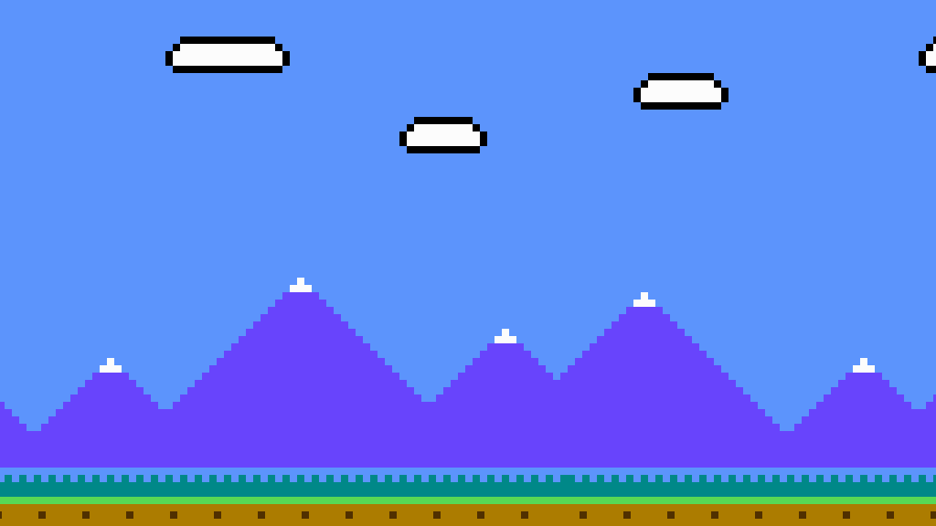
Images & Parallax Implementation
Demo: Flappy0 → Flappy2: the background and the ground, scrolling at 30 and 60
Each layer loops at its own point with %: background 412, ground 512
Notes:
Demo: open Flappy0 and Flappy2 side by side, then run Flappy2.
- Flappy1: the background and the ground, drawn
- Flappy2: both scrolling, looping with %

Slide 16
Try It: Speeds and Depth
In Flappy2:
Ground at 120, background at 15
Then swap the two speeds
What happens to the sense of depth?
Notes:
Pairs, about 5 minutes. The two constants at the top of Game1. Swapped, the ground seems further away than the hills: the eye reads slower as further.

Slide 17
Flappy 3: The Bird and the Art Class
From Flappy2: a Bird class with Update and Draw. But how does it get its texture?
A static field in Game1
breaks encapsulation,
Game1 grows
Pass it in
tedious for
every new entity
A static ContentManager
everything can
load anything
A static Art class
one place
for every asset
Which would you pick? We go with Art, and move the background and ground into it too.
Notes:
Ask the question before revealing the answer: how does the Bird get its texture? Let them argue for each box.
We pick a static Art class: one place for every asset. Its cost: it’s global. We come back to that with Singleton.
Full instructions are on the course site; students work from there. Walk round while they work.

Slide 18
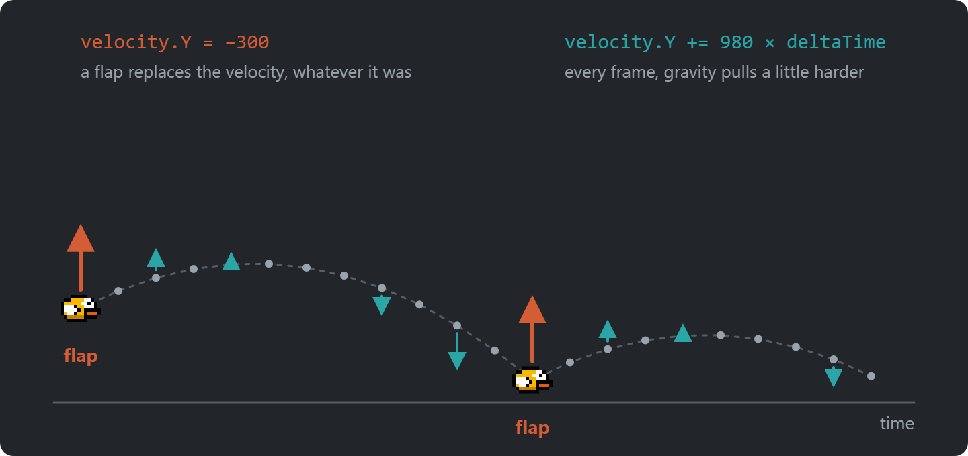
Gravity
Notes:
Gravity adds to the velocity every frame, so the bird falls faster and faster. A flap replaces the velocity, whatever it was.
Ask: why set the velocity on a flap, and not add to it? Answer: the flap would be weaker the faster the bird falls.

Slide 19
An Input Manager
The “just pressed” check from Pong moves into GARCore.
InputManager
updated by Core, every frame
KeyboardInfo
IsKeyDown · WasKeyJustPressed
MouseInfo
Position · WasLeftButtonJustPressed
A flap sets the vertical velocity to an upward jump force. Remember: y points down.
Notes:
Walk through the diagram: Core updates the InputManager every frame; games ask it for keys and the mouse.
A flap sets the vertical velocity upwards. Remind them: y points down.

Slide 20
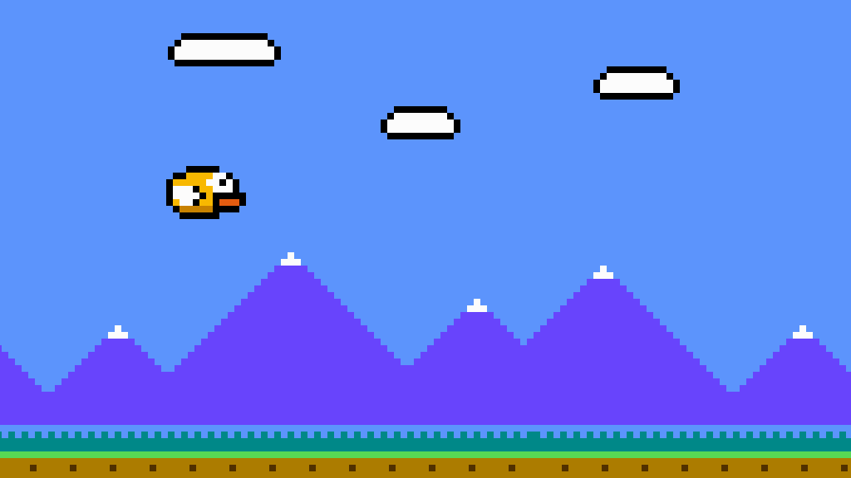
Gravity and Input Implementation
Demo: Flappy3 → Flappy5: the bird falls, and flaps on Space or a click
Notes:
Demo: open Flappy3 and Flappy5 side by side, then run Flappy5.
- Flappy4: velocity grows by gravity every frame, position follows velocity, both scaled by delta time
- Flappy5: KeyboardInfo, MouseInfo and InputManager in GARCore; the flap in Bird.Update

Slide 21
Try It: Tune the Flap
In Flappy5, in Bird:
Gravity 1500, and a jump force of 450
Flap on the Up key too
Swap WasKeyJustPressed for IsKeyDown. What does holding Space do now?
Notes:
Pairs, about 5 minutes. Gravity and JumpForce are constants in Bird.
With IsKeyDown the velocity is set every frame, so the bird rises steadily while the key is held. That is the cave flyer in the Going further exercise.

Slide 22
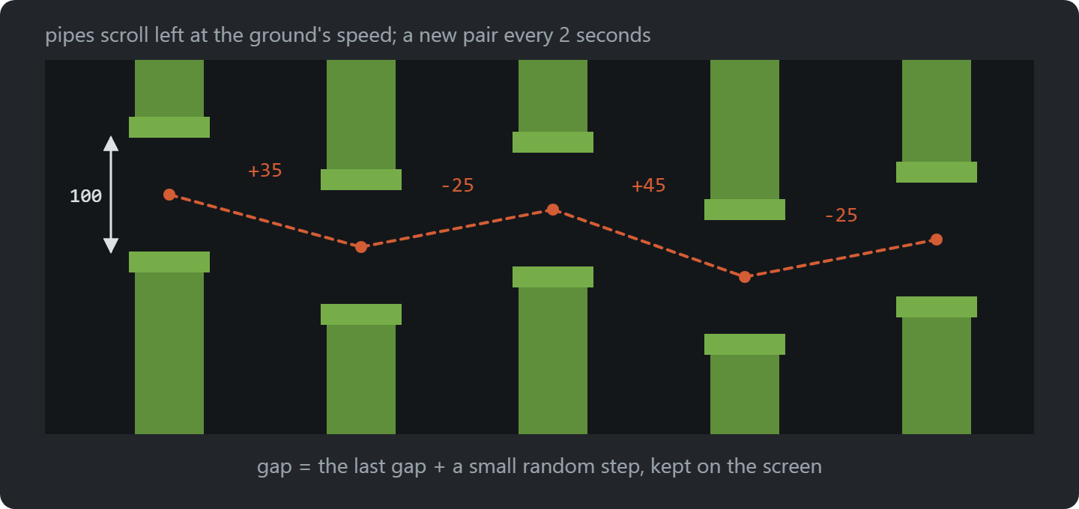
Procedural Generation
Notes:
Content made by rules instead of by hand. Here: where each pipe gap goes. Walk through the figure’s quantities.

Slide 23
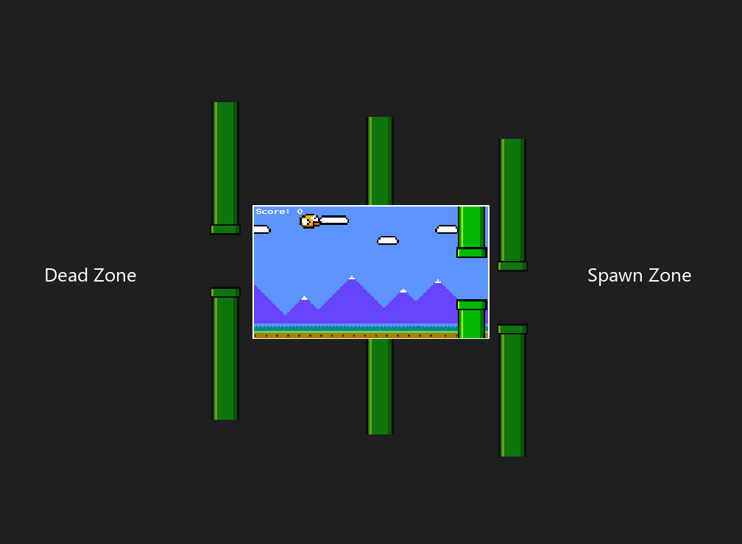
Notes:
Pipes spawn off-screen on the right (the spawn zone) and are removed after they leave on the left (the dead zone). The player only ever sees the middle.

Slide 24
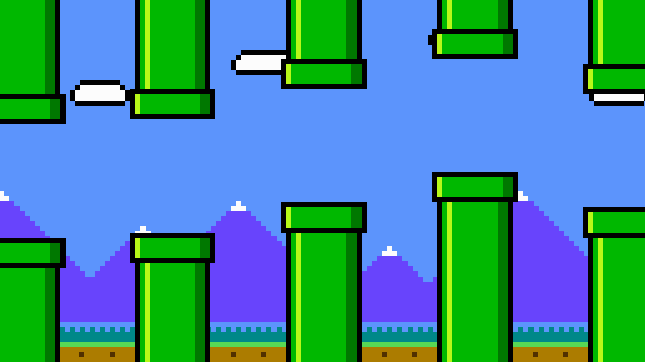
Procedural Generation Implementation
Demo: Flappy5 → Flappy7: pipes on a timer, then pairs with a drifting gap
A PipePair wraps two pipes; pairs that leave the screen are removed.
Notes:
Demo: open Flappy5 and Flappy7 side by side, then run Flappy7.
- Flappy6: a pipe on a timer, at a random height
- Flappy7: PipePair, the drifting gap, and removing pairs off-screen

Slide 25
Try It: A Harder Gap
In Flappy7:
A 80-pixel gap, and a pair every 1.5 seconds
Is it still fair?
Which numbers in SpawnPipePair make the drift gentler?
Notes:
Pairs, about 5 minutes. PipeGap in PipePair, PipeSpawnInterval in Game1. The drift: the random step (-50 to 50) and the clamp in SpawnPipePair.

Slide 26
Collisions
How can we do collision detection?
  AABB, as in Pong
Notes:
Same AABB as Pong. Ask: how could collisions be more forgiving? Answer: a slightly smaller hitbox than the sprite.

Slide 27
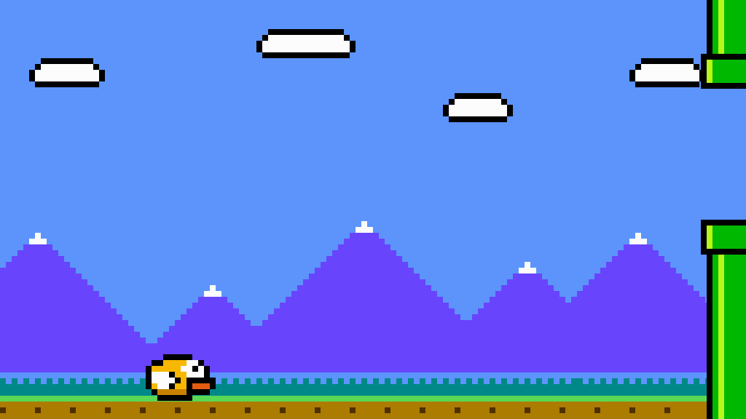
Flappy 8: Hitboxes
From Flappy7: the game stops when the bird hits a pipe, the ground or the ceiling.
Can you make the collisions a little more forgiving?
Notes:
Exercise: stop on hitting a pipe, the ground or the ceiling.
Full instructions are on the course site; students work from there. Walk round while they work.

Slide 28
State
Do you remember how game state was handled in the Pong game?
  Why is this potentially “problematic”?
Notes:
Ask: how did Pong handle its modes? A string. Why is that fragile? Typos, and an if-chain in every method.

Slide 29
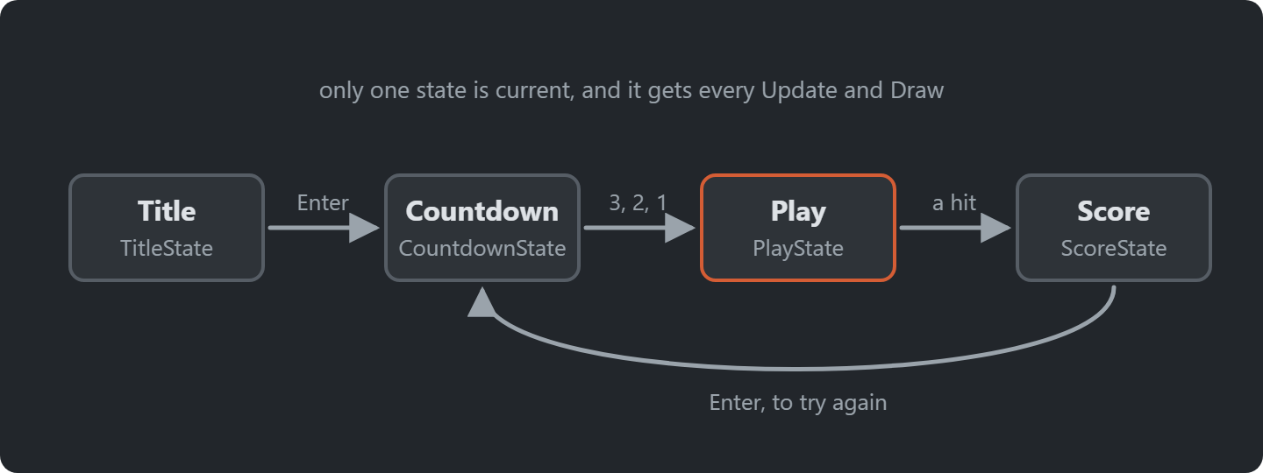
The States of the Game
Notes:
The game’s states and what moves between them. Each state is a class with the same four methods.

Slide 30
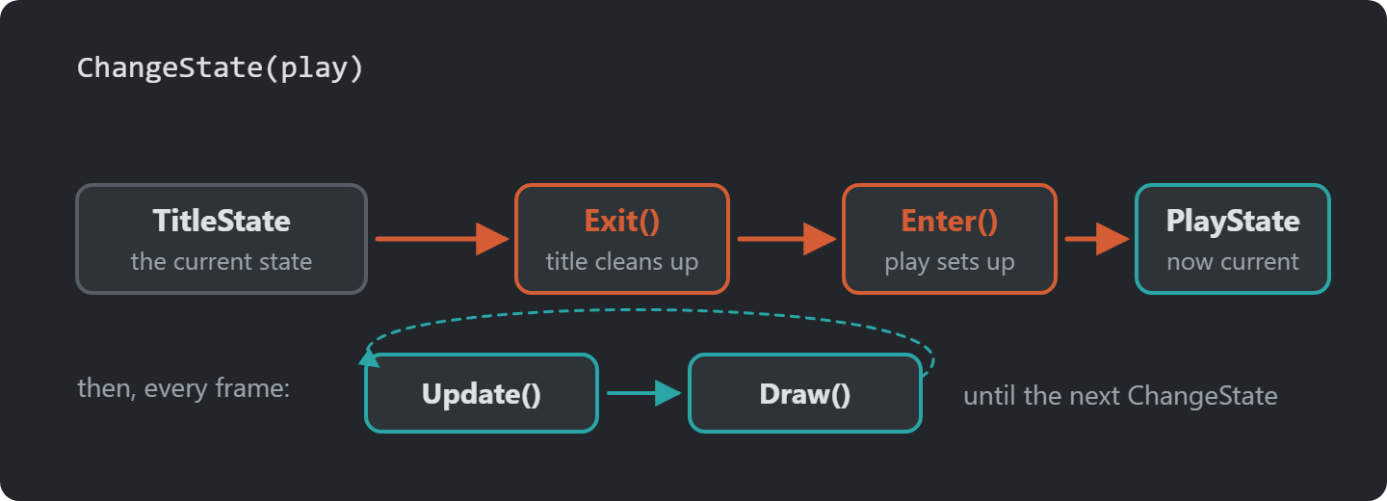
Notes:
The life of a state: Enter once, Update and Draw every frame, Exit once. Enter resets, Exit cleans up.

Slide 31
Interfaces
public interface IState
{
void Enter();
void Exit();
void Update(GameTime gameTime);
void Draw(SpriteBatch spriteBatch);
}
public class PlayState : IState
{
public void Enter()
{
}
public void Exit()
{
}
public void Update(GameTime gameTime)
{
}
public void Draw(SpriteBatch spriteBatch)
{
}
}
Notes:
IState is the contract: every state has Enter, Exit, Update and Draw. The machine only knows the interface.

Slide 32
public class StateMachine(Game1 game)
{
private IState _currentState;
public TitleState TitleState { get; private set; } = new TitleState(game);
public PlayState PlayState { get; private set; } = new PlayState(game);
public void ChangeState(IState newState)
{
_currentState?.Exit();
_currentState = newState;
_currentState.Enter();
}
public void Update(GameTime gameTime)
{
_currentState?.Update(gameTime);
}
public void Draw(SpriteBatch spriteBatch)
{
_currentState?.Draw(spriteBatch);
}
}
Notes:
The StateMachine: ChangeState calls Exit on the old state and Enter on the new one. Update and Draw go to the current state.

Slide 33
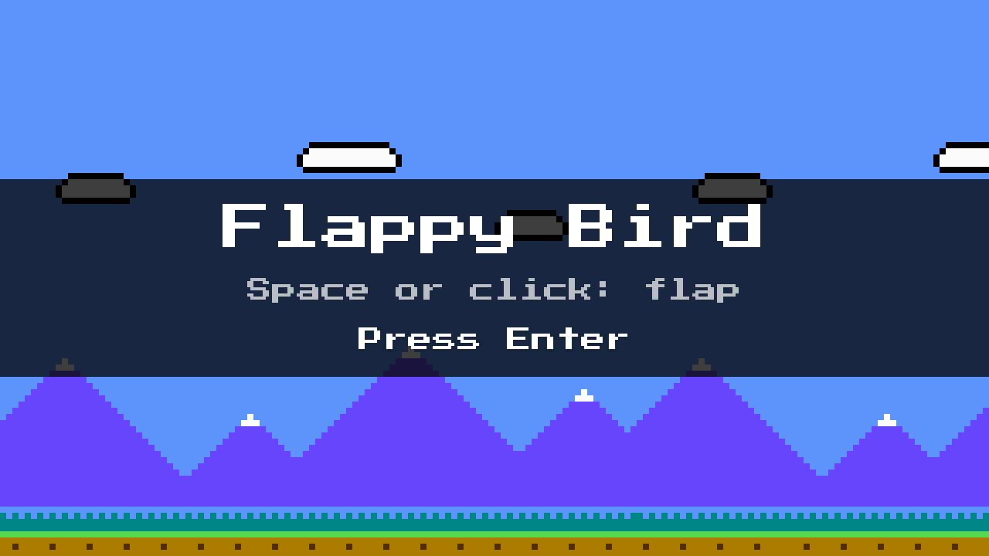
Flappy 9: A State Machine
Goal: an IState interface, a state machine, a title state and a play state.
Most of Game1’s gameplay code moves into the play state.
What goes in Enter, and why not in the constructor?
Notes:
Exercise: IState, a StateMachine, a title state and a play state.
Full instructions are on the course site; students work from there. Walk round while they work.

Slide 34
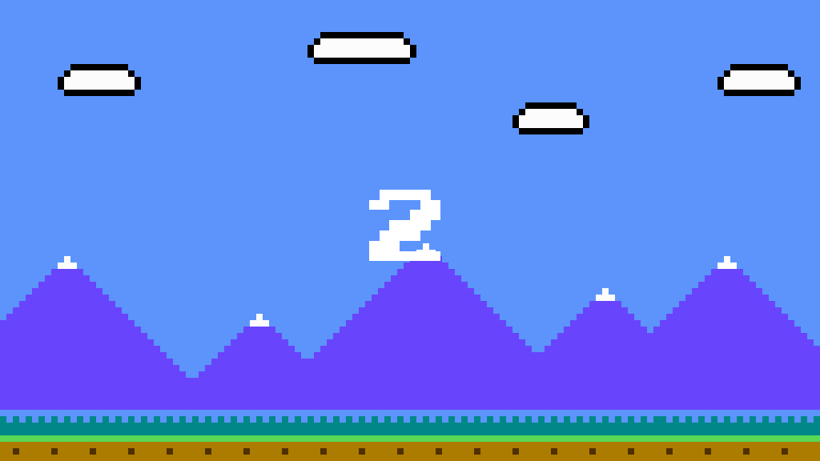
Score and Countdown Implementation
Demo: Flappy9 → Flappy11: a score state that reads the score, and a countdown from 3
Notes:
Demo: open Flappy9 and Flappy11 side by side, then run Flappy11.
- Flappy10: a point per pair; ScoreState reads the score through the state machine
- Flappy11: CountdownState, 3, 2, 1, between the title or score and play

Slide 35
Try It: Countdown and Best Score
In Flappy11:
Start the countdown at 5, and tick every 0.3 seconds
Show a best score on the score screen
Where does it live, so it survives the next game?
Notes:
Pairs, about 6 minutes. Count and Interval in CountdownState. The best score can live in ScoreState or PlayState: the state objects are made once and reused, so a field survives.

Slide 36
Flappy 12: Audio as a Singleton
From Flappy11: music, and sounds for flap, hurt and score.
In an Audio class, made a Singleton: Audio.Instance.PlayFlap()
Which classes use Audio? Do their constructors show it?
Song + MediaPlayer.Play: the music
SoundEffect: flap, hurt (+ explosion), score
Notes:
Exercise: music and three sounds, in an Audio class made a Singleton. Next: is that a good idea?
Full instructions are on the course site; students work from there. Walk round while they work.

Slide 37
You Made it (Again)!
Congratulations! You now have your very own working Flappy Bird Game made with MonoGame.
Notes:
The whole game works. Now the design question we skipped: global access.

Slide 38
Singleton Pattern: Problem
“Ensure that only one instance of the singleton class ever exists
and provide global access to that instance.”
Gang of Four, Design Patterns
Notes:
The Gang of Four’s definition: one instance, and global access to it.

Slide 39
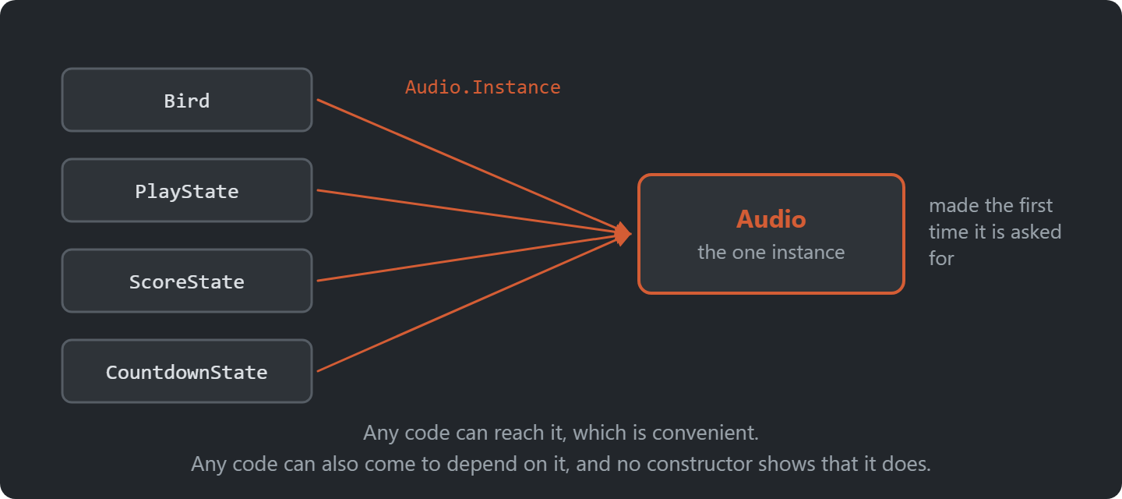
One Instance, Reached From Anywhere
Notes:
Every class on the left reaches the same Audio object through Audio.Instance.
Ask: which of these classes depend on Audio, judging by their constructors? Answer: you cannot tell, and that is the cost.

Slide 40
Singleton Pattern: Solution
public class Singleton
{
private static Singleton _instance;
public static Singleton Instance
{
get
{
_instance ??= new Singleton();
return _instance;
}
}
}
Notes:
The classic implementation. Note: simple, but not thread safe; fine for our games.

Slide 41
Singleton Pattern: Usage
“Friends don’t let friends create singletons”
Robert Nystrom, “Game Programming Patterns”
Notes:
Nystrom’s warning. Ask: why? Answer: global state, hidden dependencies, hard to replace in a test.

Slide 42
Singleton in Flappy Bird
Audio is a Singleton: one object, reached through Audio.Instance
Art is a static class
Both give global access
But Audio is an object
  It could implement an interface or be passed as a parameter
  Pokemon builds on this with a Service Locator
Step: Flappy12
public class Audio
{
public static Audio Instance { get; }
= new Audio();
private Audio() { }
public void PlayFlap() => _flap.Play();
// PlayMusic, PlayScore, PlayCrash...
}
// Anywhere in the game
Audio.Instance.PlayFlap();
Notes:
Art is a static class, Audio a Singleton. Both global; but Audio is an object, so it could implement an interface. Pokemon builds on that with a Service Locator.

Slide 43
The Whole Game
Flappy12 adds music and sounds. The play state owns the bird and the pipes.
Game1 : Core
scrolls the background
StateMachine
the current state
TitleState
CountdownState
PlayState
ScoreState
Bird
PipePair
two pipes each
Art and Audio are not in the tree. Any class reaches them.
Notes:
Who holds what in the finished Flappy Bird. Game1 hands Update and Draw to the state machine; the play state owns the bird and the pipes.
Art and Audio are global, so no arrow leads to them. Ask: is that a strength of the diagram or a hole in it?

Slide 44
Summary
Six concerns, and this session’s answer to each.
How cheap a change is
Low coupling, high cohesion
Code every game needs
A class library, GARCore
Which screen the game is on
A state machine of IState objects
Levels nobody drew
Procedural generation
Depth on a flat screen
Parallax scrolling
Reaching the audio from anywhere
Singleton, and what it costs
Notes:
The session in one slide. Read each concern aloud and let the class give the answer before pointing at it.

Slide 45
Check Yourself
What problem does a state machine solve compared to a string or enum field?
What happens if you forget to call Exit() when switching state?
Why is Singleton considered an anti-pattern by many game programmers?
The answers, and more questions, are on the course site.
Notes:
Ask one question at a time. Pairs discuss for a minute, then take two or three answers.
Expected answers (from the course site):
Q: What problem does a state machine solve compared to a string or enum field?
A: Each state's behaviour is in one place. You can add a state without editing the others, and Enter/Exit give reliable places for setup and cleanup.
Q: What happens if you forget to call Exit() when switching state?
A: Anything the old state set up is never cleaned up. Music keeps playing, event subscriptions stay alive and timers keep running.
Q: Why is Singleton considered an anti-pattern by many game programmers?
A: It is global state. It hides dependencies, couples code together and makes testing and reasoning harder, and games rarely need the guarantee of a single instance.

Slide 46
Apply It to Your Project
Which code in your game could another game reuse?
  That belongs in a class library, like GARCore
Which states does your game have? Draw them as a state diagram
Is anything in your game global? Does it need to be?
Notes:
Give the project groups five minutes with these questions.
Ask two groups to share one answer each, and push them to name actual classes and files.

